Slide 1
LeadingRE Referral Guide
Deliver exceptional service to your clients with your connections to the top brokers around the world.

Slide 2
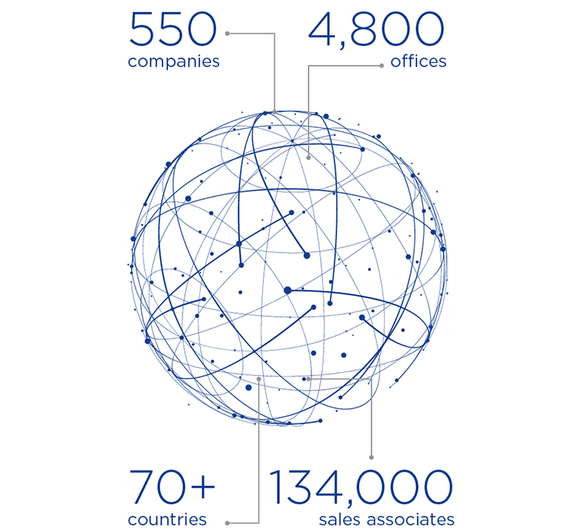
About LeadingRE

Slide 3
Importance of Outgoing Referrals
National and global connections
Expands sphere of influence
Provides full service to clients
Increase your income
Generates reciprocal incoming business from other LeadingRE brokers
Enhances your company’s national and international visibility and performance
Builds & strengthens your company, the network & affiliated brokers with market share across the country

Slide 4
Qualified Referrals
Buyer or seller with a real estate need outside of YOUR market area
Client has given permission to be contacted by destination broker
Financially qualified to buy or has legal authority to sell
Plans to visit destination or meet to discuss the listing within reasonable time frame
As much information as possible about the client and their real estate needs is provided

Slide 5
Broker-to-Broker Network Referral Process
Our Company
Destination Company
Sends referral to destination company
Sends LeadingRE the 20% network fee and splits the remainder of the referral fee with our Referral Agent
Accepts referral which results in a sale
Sends 30% referral fee to our company
Splits balance of referred side commission with Assigned Agent

Slide 6
Agent Referral Process
1
5
Introduce yourself to the Assigned
Agent and ensure contact with referred customer
Obtain permission from client
2
Assure quality service from LeadingRE companies and offer an introduction to an agent just like you
6
Follow-up with client & assigned sales associate throughout the process
3
7
Obtain complete information
(name, address, phone #’s, and email)
Successful closing = $$
4
Relay information to your Relocation Department who will reach out to the
network broker’s Relocation Department

Slide 7
Golden Referral Rules
1. All outbound referrals to be placed and assigned through the Relocation Department
2. Referrals are between brokers, not sales associates
3. Relocation will place with a specifically requested agent or professional designee when possible
4. Only Relocation Director, and/or Sales Manager should sign all referral agreements (depending on your company policy)
5. Agents should not sign any referral agreements

Slide 8
Sample Referral Fee Calculation
Sales Price $300,000
Sales Commission at 6% $18,000
Commission on referred side 3% $9,000
30% referral fee to referring company $2,700
Less 20% fee to Network $540
Remainder $2,160*
Split between agent and company total = $2,160*
(insert whatever company split you offer)

Slide 9
Why Use LeadingRE Brokers?
It’s an independent brokerage just like yours
Build reciprocal business and increases market share of our network
Retains membership across the country
High conversion rates & client satisfaction
Network brokers and agents are relocation trained with excellent local and national reputations
Brokers assign referrals to specially trained, experienced agents
It’s our contractual obligation and a major benefit of being a network member

Slide 10
LeadingRE’s Outgoing Referral Expectations of Our Company
1
Minimum of one outgoing referral sent per sales associate each year
2
Regular, consistent follow-up on active referrals sent to you
3
Conversion rate at or above network standards
4
Refer to network members always (keep it in the family)
5
Brokerage is contractually obligated to pay the LeadingRE transaction fee on every closed referral.

Slide 11
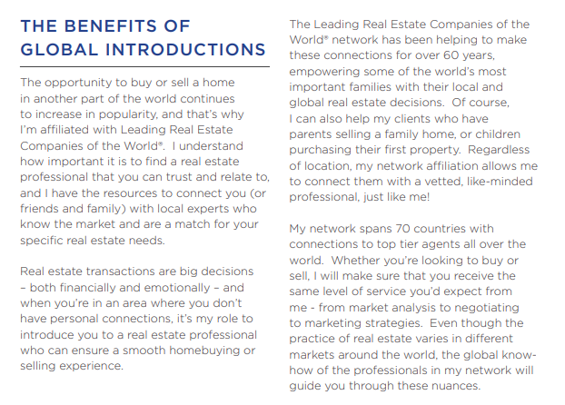
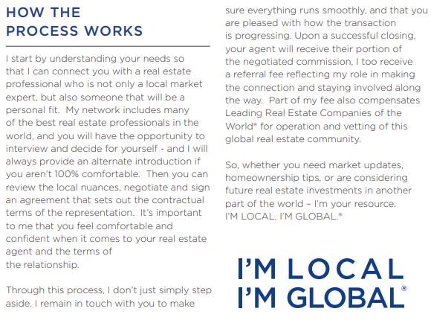
Global introductions brochure
Website to brochure – playbook.leadingre.com
Transparency – benefits to consumer and how the process works

Slide 12
LeadingREs Global Referral Concierge Program

Slide 13
Information required to place a Global Referral
Client Consent: Confirm the client agrees to be referred.
Client Information: Name, contact info, and preferred communication method.
Location: City, State/Province, and Country.
Referral Type: Buyer, Seller, or Renter.
Timeline: When does the client want to purchase, sell, or rent?
Property Details: Residential, commercial, land, etc.
Budget for buying or approximate value if selling.
https://form.jotform.com/LeadingREMemberServices/global-referral
Notes:
A lot of the information that you need to send for global referrals is the same information that you would send for a domestic referral. I used to be a Relocation Director and I used to love the referrals for Chicago, IL. Chicago is over 200 square miles with 77 communities, I would need more information to place that referral, so be as specific as possible. Thinking about the information that you need when you get an incoming referral, and make sure to include that in your email to us. You all know this, the quicker we can get the information the quicker we can get the referral placed for you. If there is information missing that we need we are going to send you a link to a form for you to fill out. You can also submit referrals directly to this form instead of sending it via email to us and we will acknowledge in an email to you that we have received it and will start working on it right away. The link to the form is on the slide there but if you ever need it again, just email connect@leadingre.com

